Slide 1
Tracking Dangerous network users
Tim Reilly

Slide 2
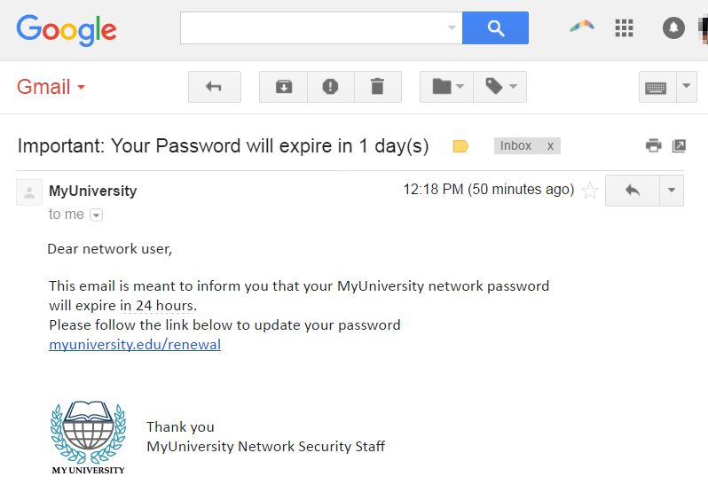
Why do we want to predict a cyber security attack?
Average users do not have a knowledge of how to safely use a computer network
People are not smart

Slide 3
What does the program do?
Analyzes the network traffic of a user and determines how likely they are to become infected with a virus
Takes into consideration how many non company approved sites the user visits

Slide 4
How does it work?
Analyzes what websites the user goes to and compares to a list of low, medium and high risk sites
Can configure a list of approved, low, medium and high risk sites
Provides a list of varying risk sites as a guideline
System administrator decides the appropriate sites for users.

Slide 5
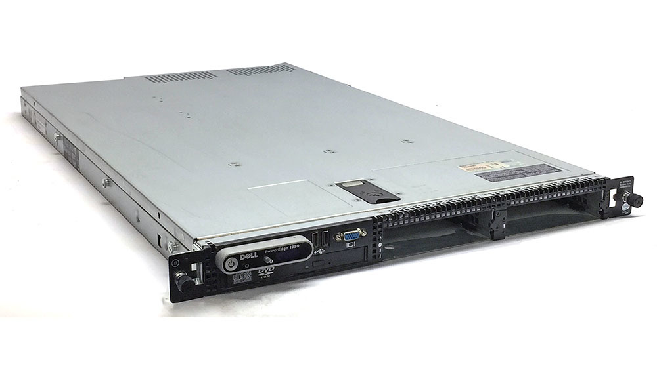
Where can this be deployed?
Routers running linux (centos or RHEL)
Any device that can capture wireshark packets

Slide 6

How will I be using this?
Will be added to my home network in order to track what potentially dangerous sites are being used

Slide 7
Demo!

